Slide 1

AULA 083
Tarefa de tempo de reação serial
Aprendizagem implícita

Slide 2
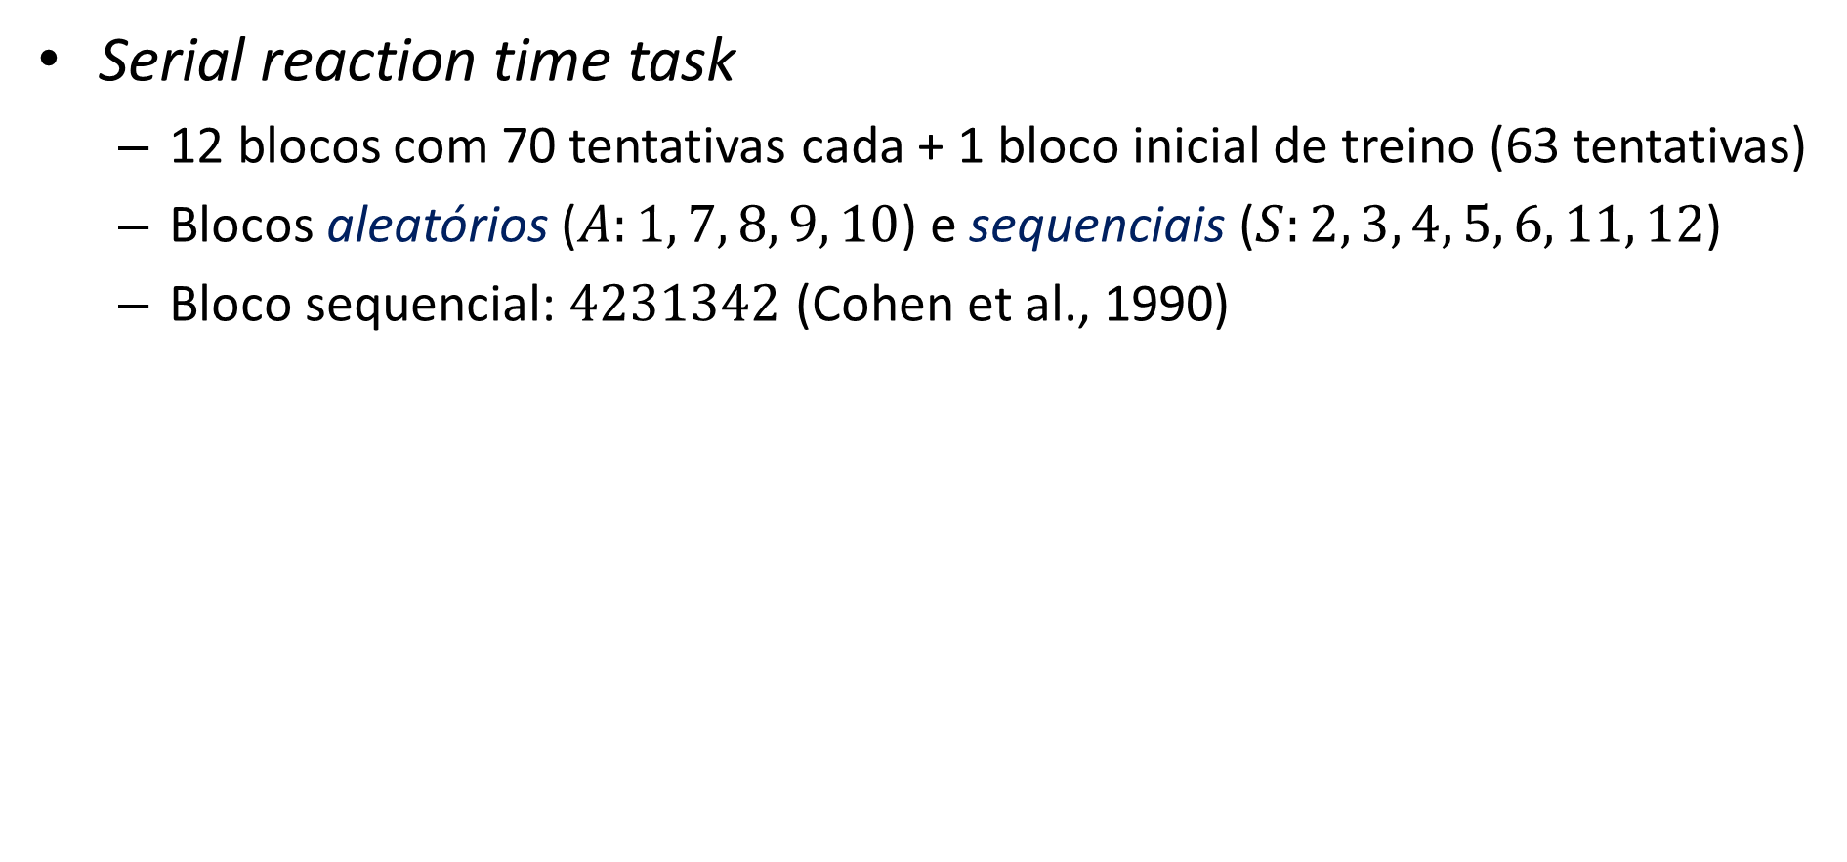
Tarefa de tempo de reação serial (Unsworth & Engle, 2005)
Serial reaction time task
  12 blocos com 70 tentativas cada + 1 bloco inicial de treino (63 tentativas)
  Blocos aleatórios ($A:1, 7, 8, 9, 10$) e sequenciais ($S:2, 3, 4, 5, 6, 11, 12$)
  Bloco sequencial: $4231342$ (Cohen et al., 1990)
*
1
2
3
4
D
F
J
K
500 ms
Até a resposta
tempo

Slide 3
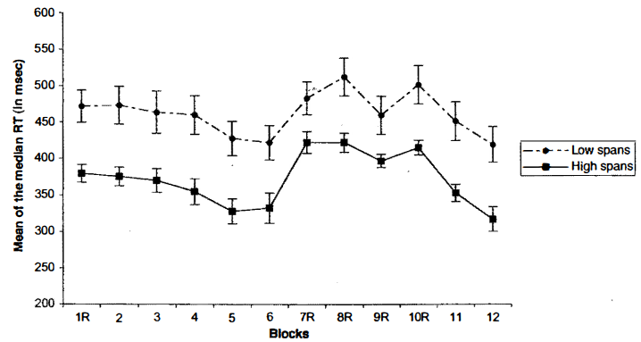
Tarefa de tempo de reação serial (Unsworth & Engle, 2005)

Slide 4
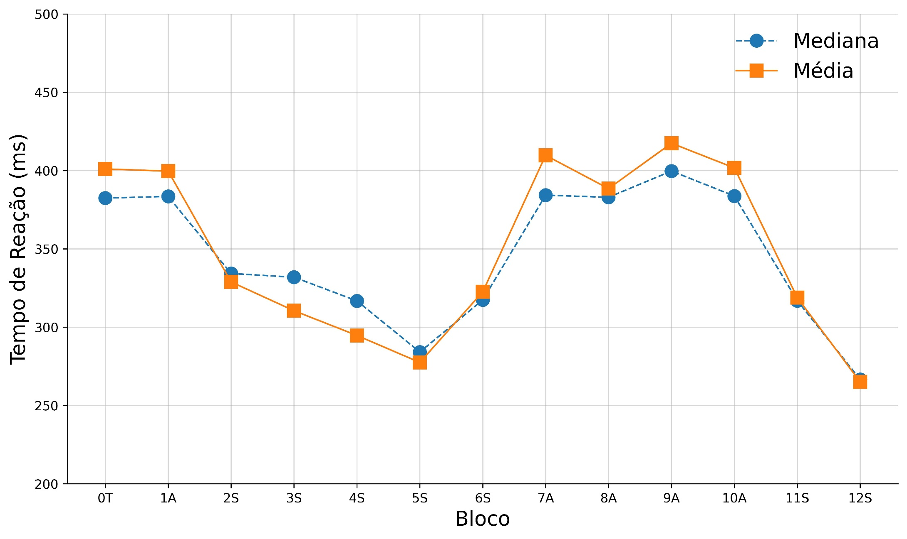
Tarefa de tempo de reação serial: meu desempenho

Slide 5
Referências
Cohen, A., Ivry, R., & Keele, S. (1990). Attention and structure in sequence learning. Journal of Experimental Psychology: Learning, Memory, & Cognition, 16(1), 17–30. https://doi.org/10.1037/0278-7393.16.1.17
Nissen, M. J., & Bullemer, P. (1987). Attentional requirements of learning: Evidence from performance measures. Cognitive Psychology, 19(1), 1–32. https://doi.org/10.1016/0010-0285(87)90002-8
Unsworth, N., & Engle, R. W. (2005). Individual differences in working memory capacity and learning: Evidence from the serial reaction time task. Memory & Cognition, 33(2), 213–220. https://doi.org/10.3758/bf03195310

